Slide 1
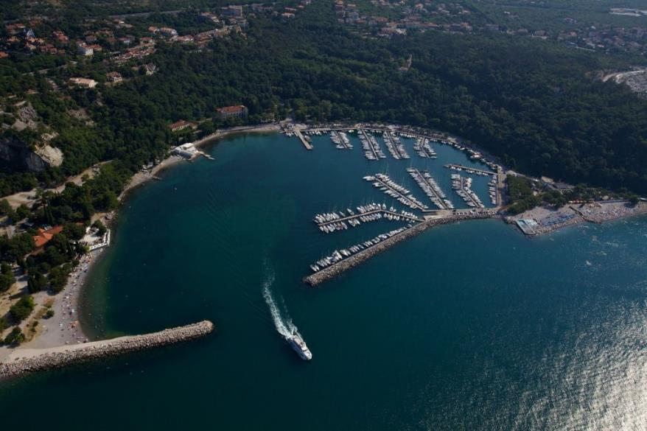
Associazione sportiva dilettantistica
Diporto
Nautico
Sistiana
2022 ORC SPORTBOAT
EUROPEAN
CHAMPIONSHIP
in SISTIANA
10-16 ottobre 2022

Slide 2

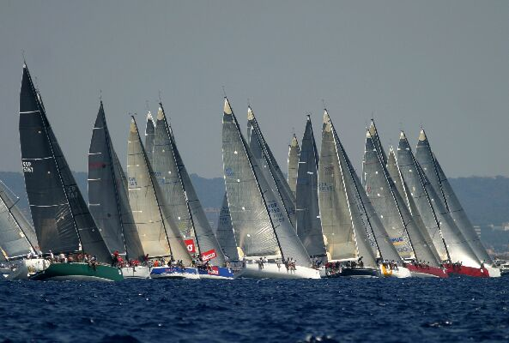




THE CLUB
The Diporto Nautico di Sistiana is a small but well-established sailing club with 170 members, affiliated with the FIV (Italian sailing federation) and UVAI, which enjoys an enviable nautical base within the Bay of Sistiana.
Notes:
2

Slide 3
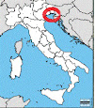
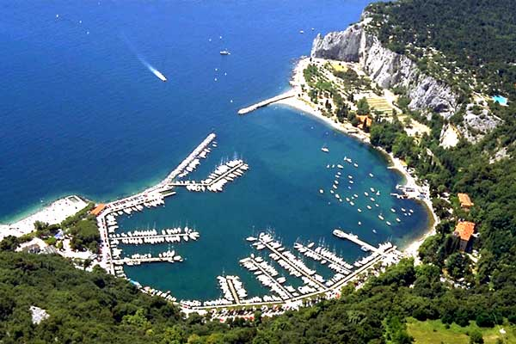
THE LOCATION
Sistiana is located in the north-eastern part of the Adriatic Sea, near Trieste, at the crossroads of the main European cultural and trade routes. It is bordered by Slovenia and Croatia to the south-east, Austria to the north.
BAY OF SISTIANA
Notes:
3

Slide 4
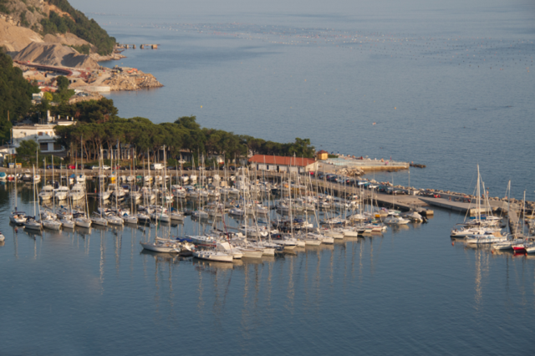
DNS BERTHS
The club manages 3 piers with 130 berths equipped with energy, water and all necessary services
Notes:
4

Slide 5
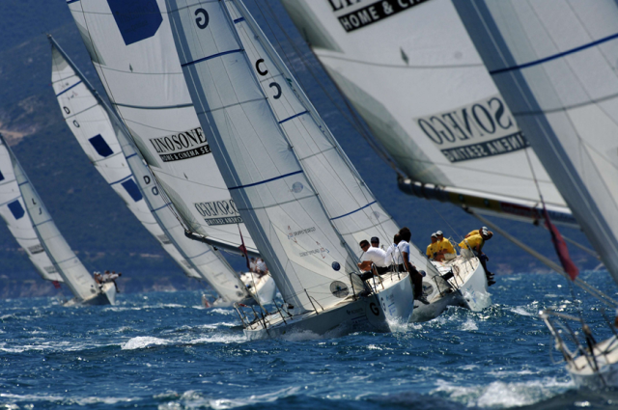
DNS MAIN SAILING ACTIVITY
The club carries out mainly activities in the offshore sailing both by organizing race events and by the technical-economic support to members and their crews.
Notes:
5

Slide 6
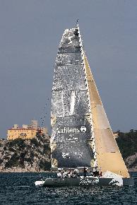

ORGANIZATION OF
SPORTBOAT EVENTS
The club has already organized the 2018 edition of the ORC European Sportboat Championship together with YC Portopiccolo and for two years the Italian Minialtura Championship.
Our experience comes from many years of organizing race events both at local level (Sistiana Sailing Week, Maxi Race, Rilke Cup) and at national or European level (class championships)
Notes:
6

Slide 7
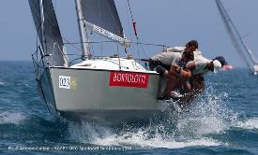
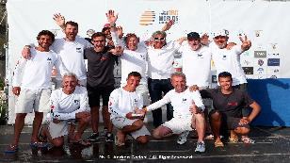
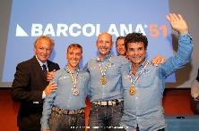
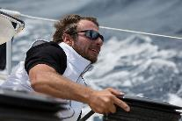
DNS has promoted its competitive team (Sistiana Sailing Team) to be protagonist in events of national and international relevance
DNS RACING TEAM
BEST RESULT
2019 Orc Sportboat
European champion
Orc World Championship
2019 – 1° and 3° class.
Italian offshore
2019 champions
double handed
2021 Orc European champion and ORC Italian champion

Slide 8



PATRONAGE AND SUPPORT
Italian National Olympic Committee
FVG
Italian Sailing Federation
Italian Union
Offshore Sailing
Regione Autonoma
FRIULI VENEZIA
GIULIA
municipality of
DUINO-AURISINA
Notes:
8

Slide 9

MAIN TECHNICAL SUPPORT
The first International Circuit of the Upper Adriatic for the ORC and SPORTBOAT Classes
The sailing clubs that manage the NARC circuit will collaborate in the organization and logistic of the championship
The NARC 2022 events (3 training sessions and 10 days of racing) will be aimed at preparing the SPORTBOAT crews for the European Championship
Notes:
9

Slide 10
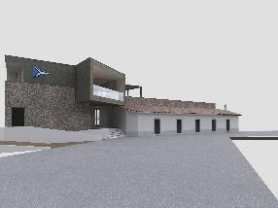
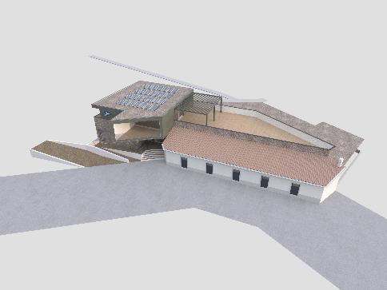
DNS NEW CLUBHOUSE
area of 750sqm, 350sqm of office, training room, services and bar restaurant and 160sqm of terrace
scheduled to open in May 2022
Notes:
10

Slide 11
EVENT PROGRAM
9 oct - boats mooring and check-in
10-11 oct - boats mooring and check-in
- teams registration
- boat measurements and launching
11 oct - practice race
- open ceremony
12 oct - skipper meeting
- coastal/offshore race
13-14 oct - inshore races
- crew and gala party
15 oct - inshore races
- prize-giving ceremony
16 oct - boats hauling out
Notes:
11

Slide 12
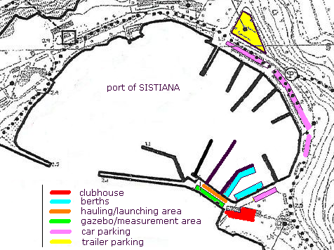
LOGISTICS AREAS
Notes:
12

Slide 13
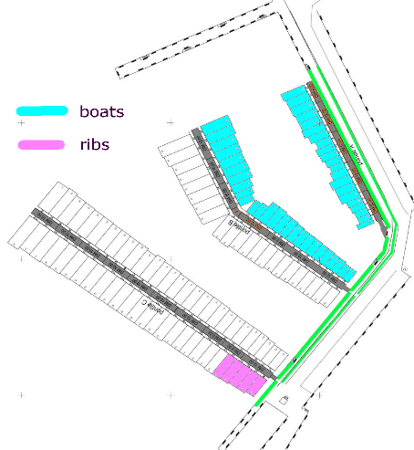
COMPETITORS MOORINGS
48 berths for competitors
width 2,75 – 3,50 mt
length 7,00 - 10,00 mt
6 berths for ribs
Notes:
13

Slide 14
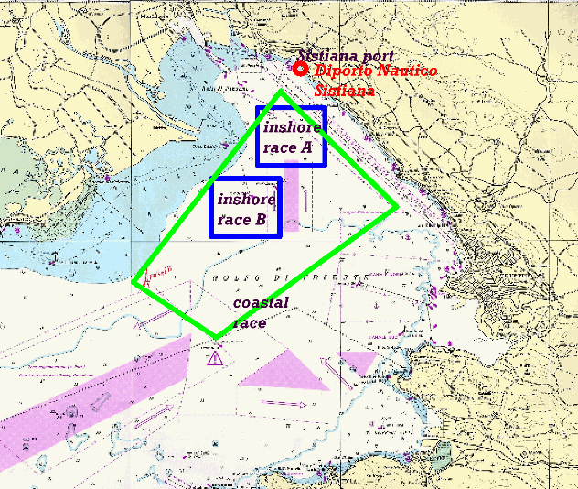
RACING AREAS
one large area for the coastal-offshore race (10 to 25 miles) and two possible areas for the inshore races
Notes:
14

Slide 15
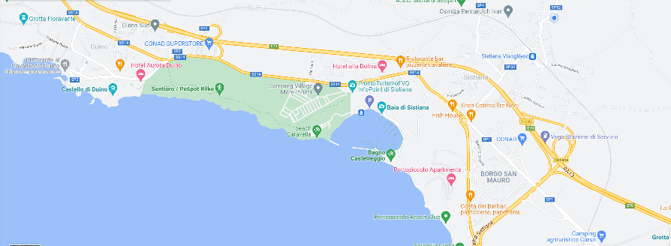
ACCOMODATION & CATERING
in the SISTIANA area are available :
- about 30 hotel and bed&breakfast
- 2 campings with bungalows
- about 50 restaurant or “trattoria”
Notes:
15

Slide 16
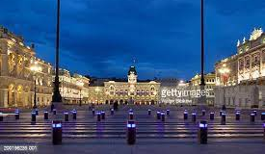
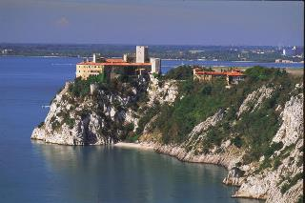
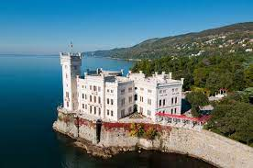

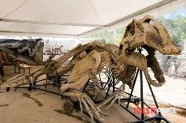
NEARBY TOURIST SITES
Duino castle (3km)
Trieste (15km)
Paleontological
Site –Villaggio del
Pescatore (3km)
Carso
Giant cave (5km)
Miramare castle (10km)
Notes:
16

Slide 17
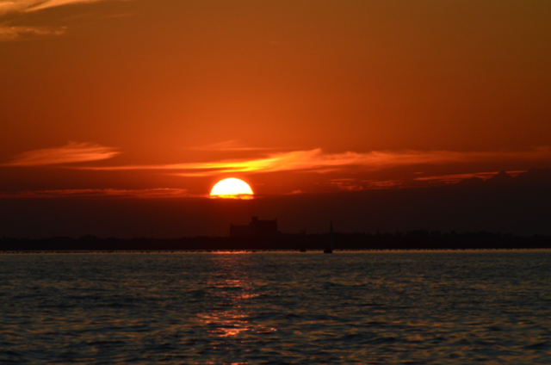
Associazione sportiva dilettantistica
Diporto
Nautico
Sistiana
THANK YOU
for your
attention

